Slide 1
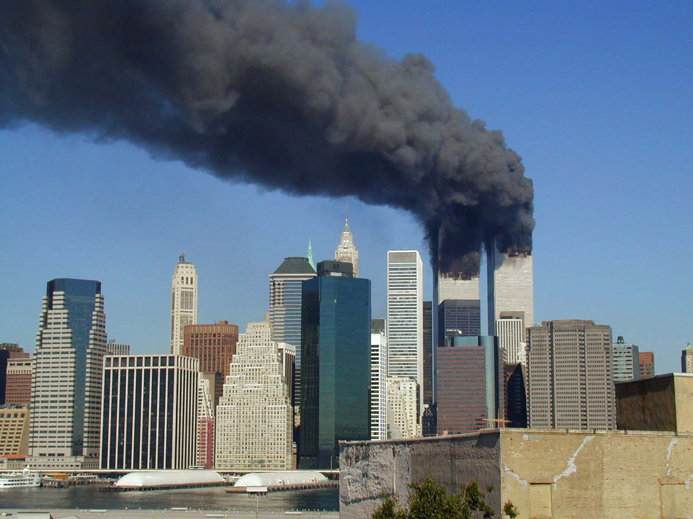
Terrorism
Analysing the Global Terrorism Dataset

Slide 2
Project Objectives
Identify what determines a successful terrorist attack
Figure out what terrorists really aim to achieve from the attacks

Slide 3
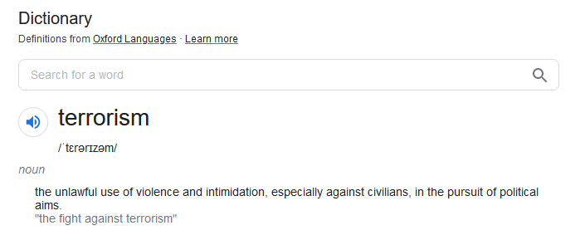

Slide 4
The dataset
EDA
Machine Learning
Final Insights

Slide 5
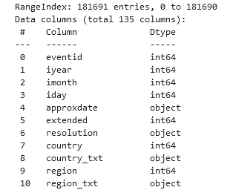
The dataset
EDA
Machine Learning
Final Insights

Slide 6
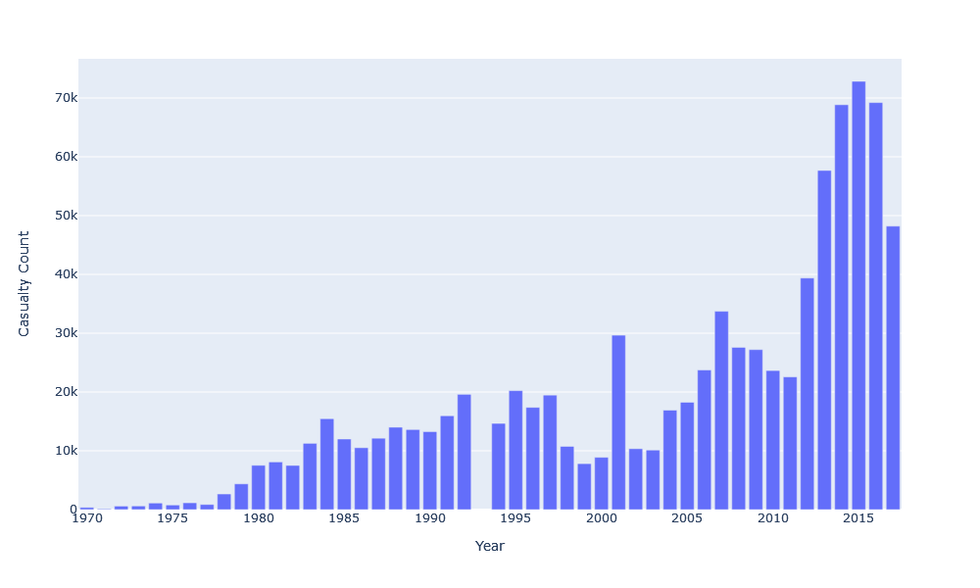
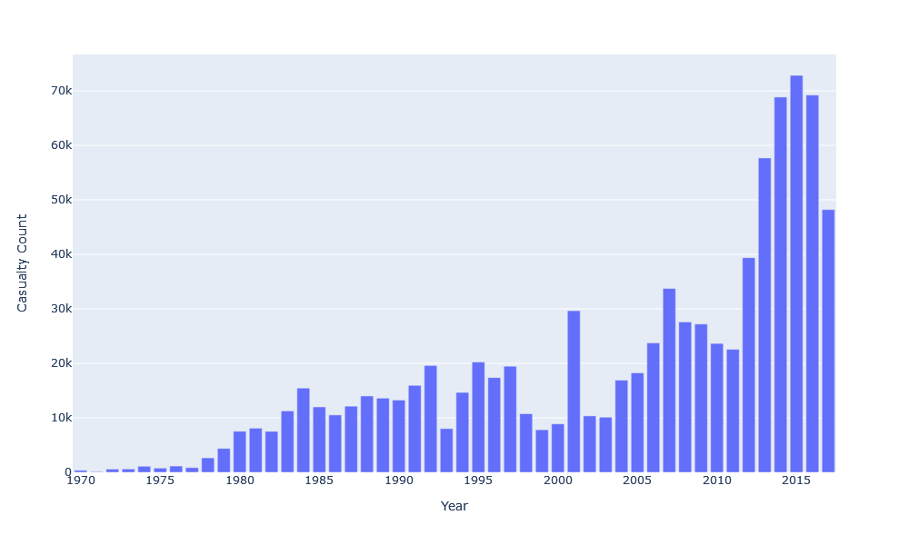
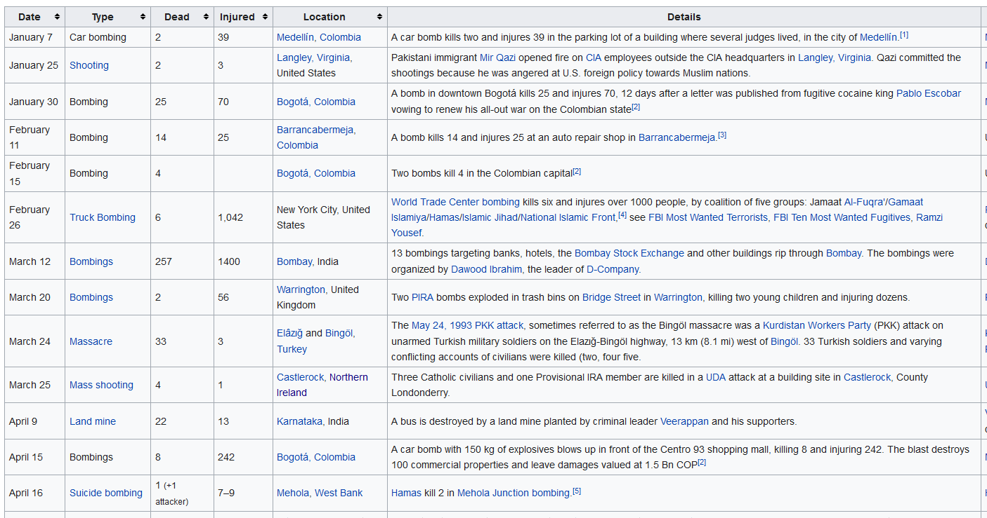
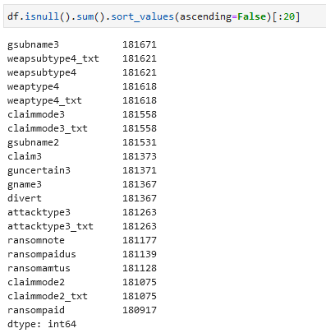
About the dataset
???
Notes:
The GTD is the most comprehensive unclassified database of terrorist attacks in the world, and is open source, meaning it is free for everyone to use.
Collection of over 180000 events, with 135 different features
Unfortunately, most of the features are unusable in our case, some with majority being null, and others being text-based data.

Slide 7
Imbalanced dataset
Weighted Logistic Regression
Oversampling/Undersampling

Slide 8
Imbalanced dataset
Weighted Logistic Regression
Oversampling/Undersampling

Slide 9
Combining kill count with wounded count - Felt it was not super useful because intensity of death is much more than wounded, just to get a general idea of the dataset

Slide 10
Introduction to libraries used (?)

Slide 11
The dataset
EDA
Machine Learning
Final Insights

Slide 12
The dataset
EDA
Machine Learning
Final Insights

Slide 13
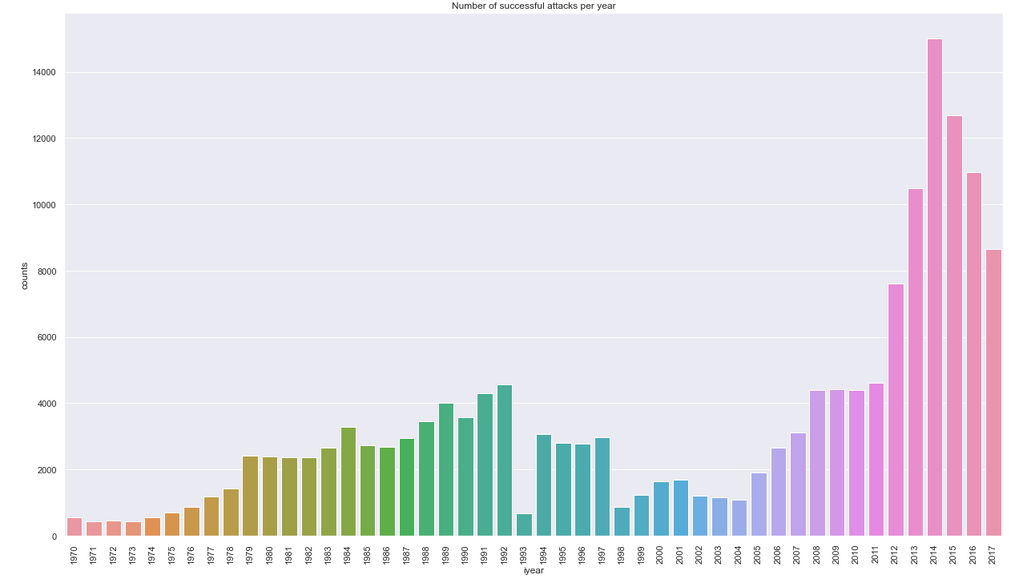
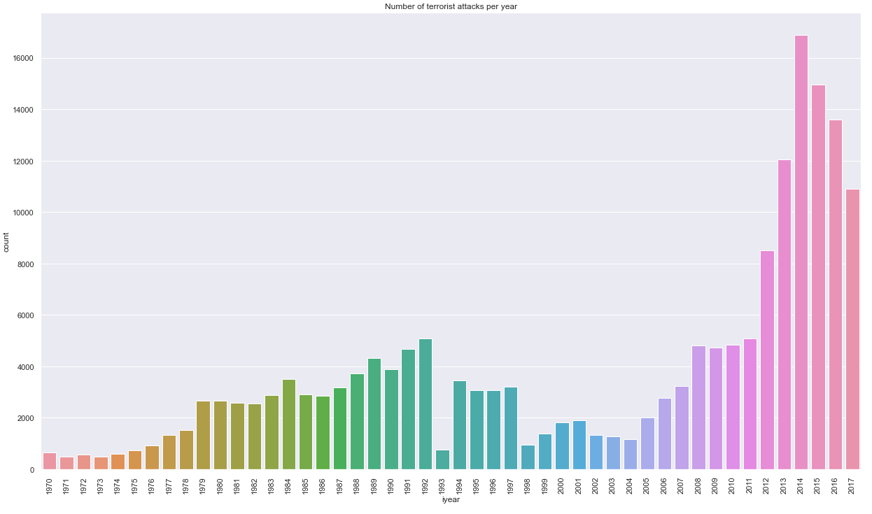
First analyse the number of attacks, number of failed attacks, success, percent of successful to get an idea of the feature we are trying to predict – how skewed, distribution etc. - show number of success:fail
Successful attacks
Total attacks
Notes:
Since our goal was to investigate what contributes to a successful attack ….

Slide 14
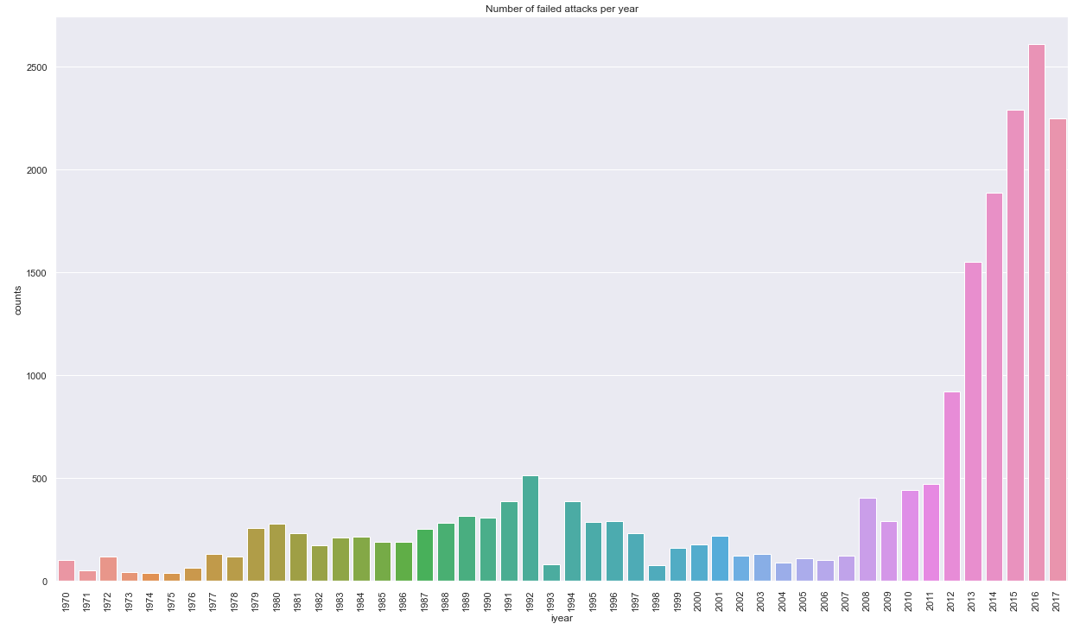
First analyse the number of attacks, number of failed attacks, success, percent of successful to get an idea of the feature we are trying to predict – how skewed, distribution etc. - show number of success:fail
Failed attacks
Successful attacks
Total attacks
Notes:
Since our goal was to investigate what contributes to a successful attack ….

Slide 15
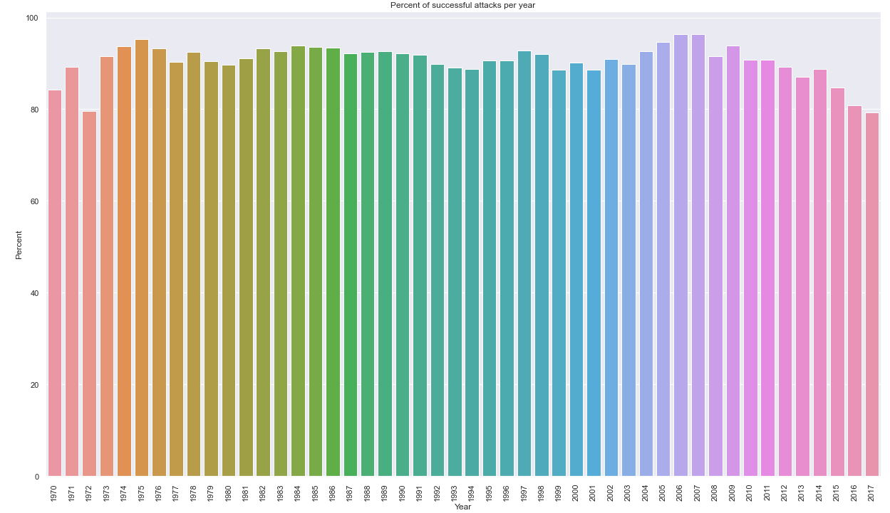
First analyse the number of attacks, number of failed attacks, success, percent of successful to get an idea of the feature we are trying to predict – how skewed, distribution etc. - show number of success:fail
Successful attacks
% successful
Failed attacks
Total attacks
Notes:
Since our goal was to investigate what contributes to a successful attack ….

Slide 16
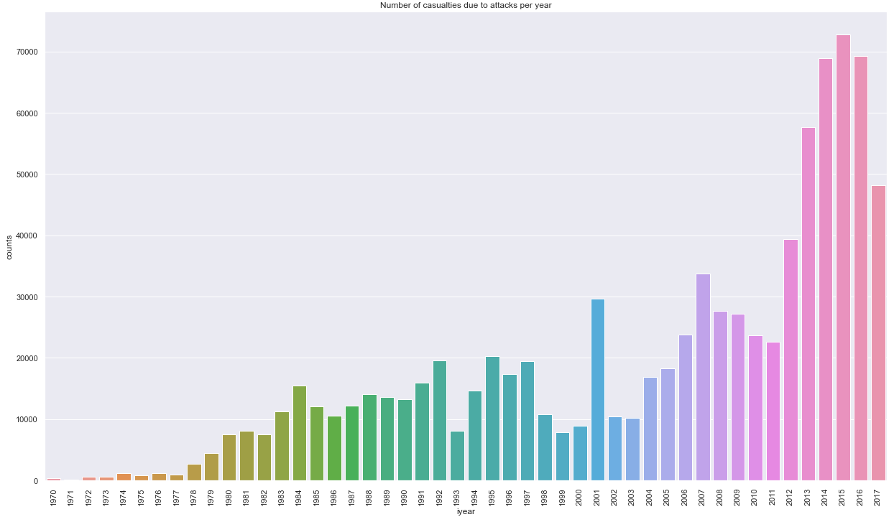
First analyse the number of attacks, number of failed attacks, success, percent of successful to get an idea of the feature we are trying to predict – how skewed, distribution etc. - show number of success:fail
Failed attacks
Successful attacks
% successful
Total attacks
Casualties
Notes:
Since our goal was to investigate what contributes to a successful attack ….

Slide 17
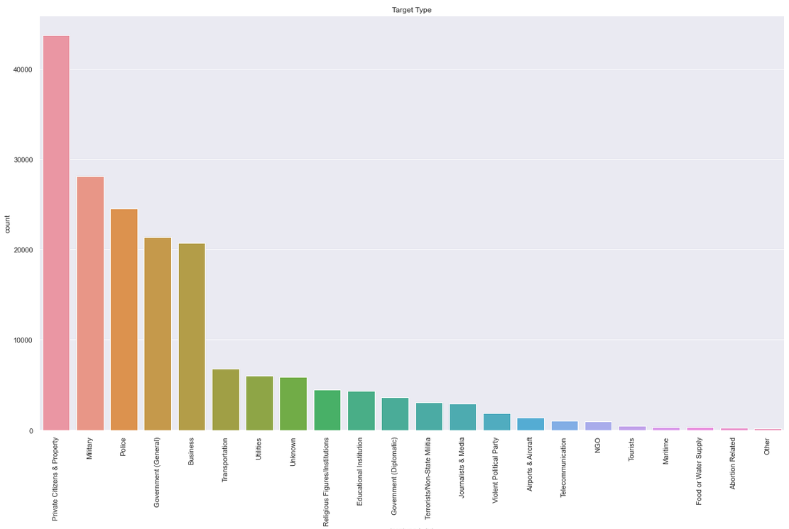
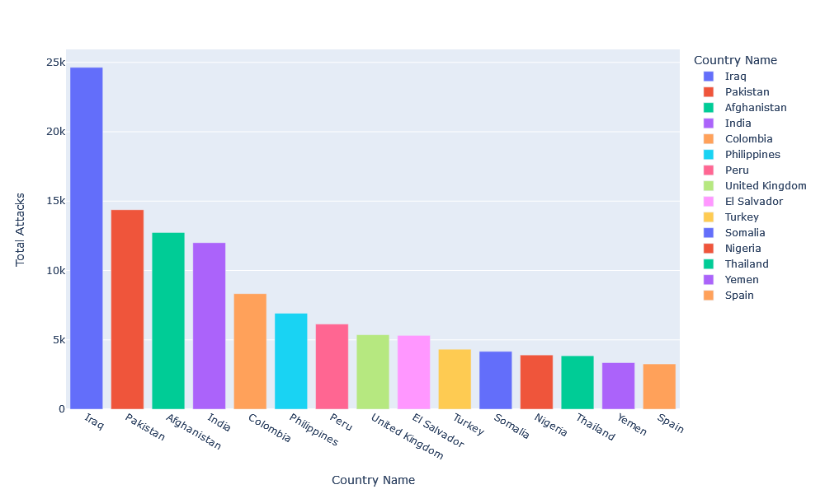
Other things we analysed were the number of casualties, most target parties and countries, as well as attack types, to see whether we could find any relation to the success
Failed attacks
Successful attacks
% successful
Total attacks
Casualties
Attack/Country
Attacks/target type
Notes:
Since our goal was to investigate what contributes to a successful attack ….

Slide 18
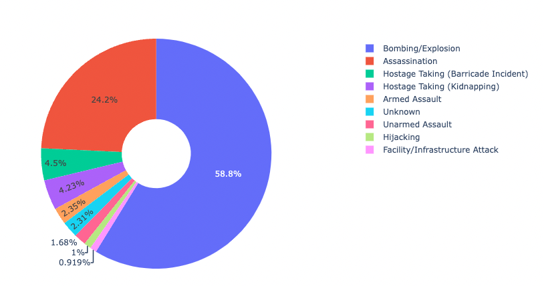
Other things we analysed were the number of casualties, most target parties and countries, as well as attack types, to see whether we could find any relation to the success
Failed attacks
Successful attacks
% successful
Total attacks
Casualties /Attack Types
Attack/Country
Attacks/target type
Notes:
Since our goal was to investigate what contributes to a successful attack ….

Slide 19
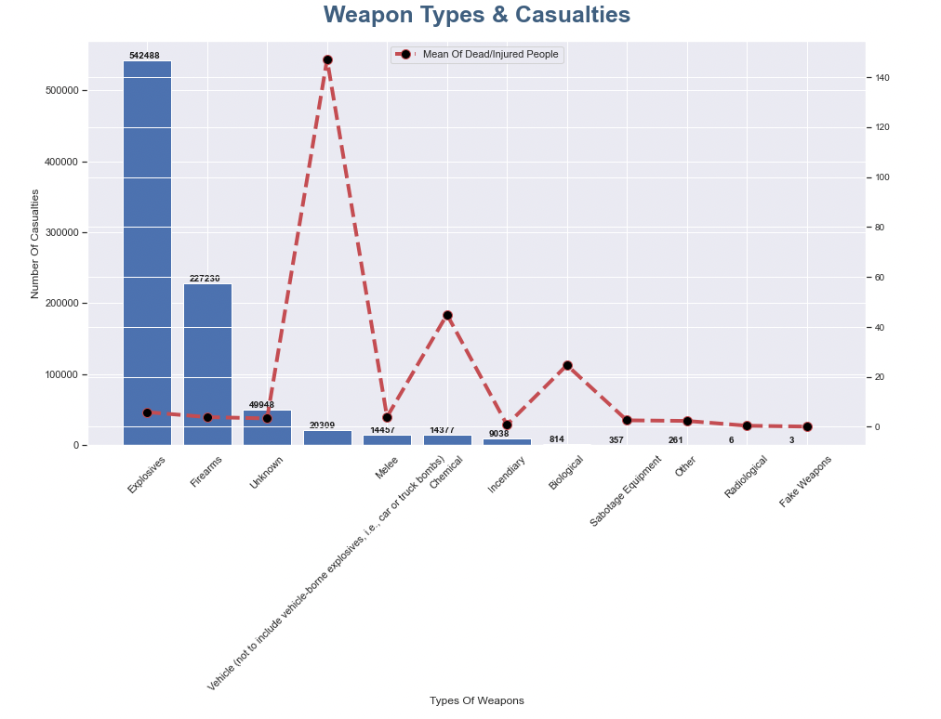
Other things we analysed were the number of casualties, most target parties and countries, as well as attack types, to see whether we could find any relation to the success
Failed attacks
Successful attacks
% successful
Total attacks
Casualties /Weapon Types
Attack/Country
Attacks/target type
Notes:
Since our goal was to investigate what contributes to a successful attack ….

Slide 20
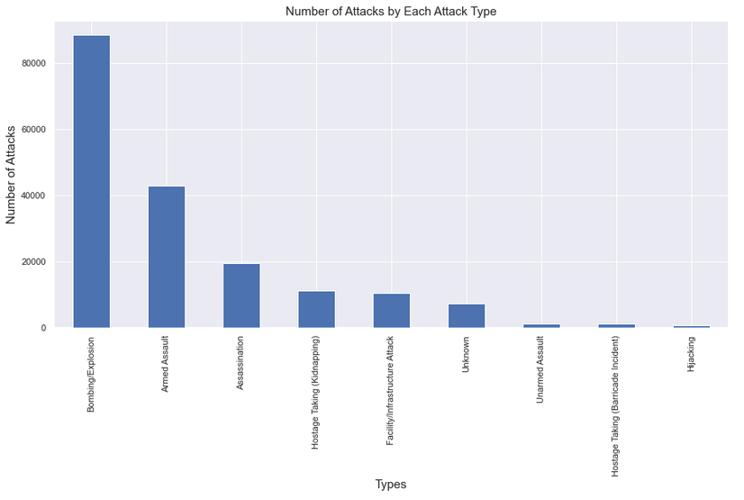
Other things we analysed were the number of casualties, most target parties and countries, as well as attack types, to see whether we could find any relation to the success
Casualties
Failed attacks
Successful attacks
% successful
Total attacks
Attack/Country
Attacks/target type
Most popular attack types
Notes:
Since our goal was to investigate what contributes to a successful attack ….

Slide 21
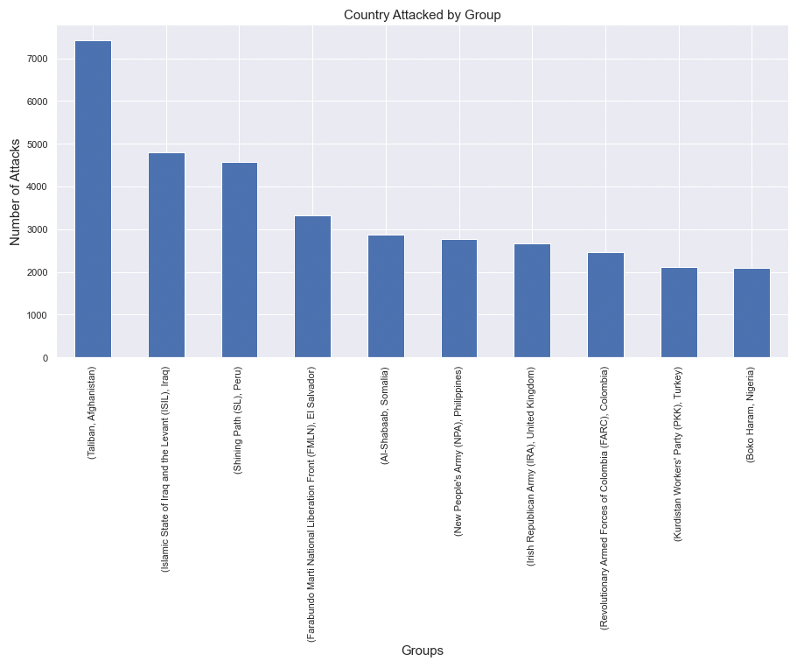
Other things we analysed were the number of casualties, most target parties and countries, as well as attack types, to see whether we could find any relation to the success
Failed attacks
Successful attacks
% successful
Total attacks
Country Attacked/Group
Attack/Country
Attacks/target type
Notes:
Since our goal was to investigate what contributes to a successful attack ….

Slide 22
Other things we analysed were the number of casualties, most target parties and countries, as well as attack types, to see whether we could find any relation to the success
Attack/Country
Attacks/target type
Most popular attack types

Slide 23
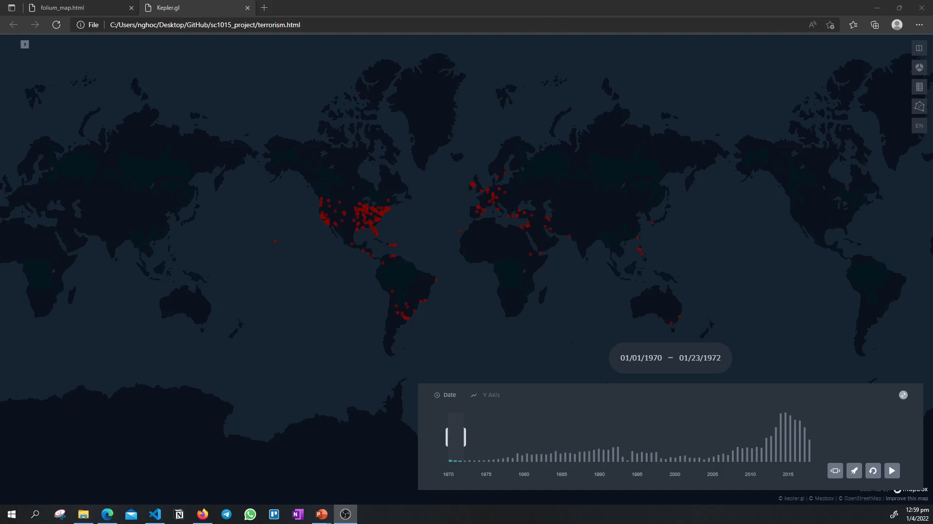
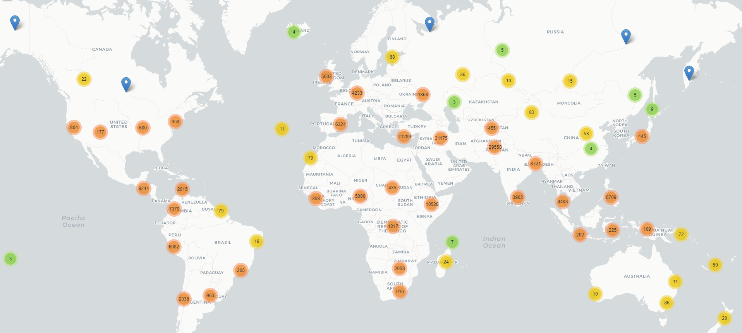

Slide 24
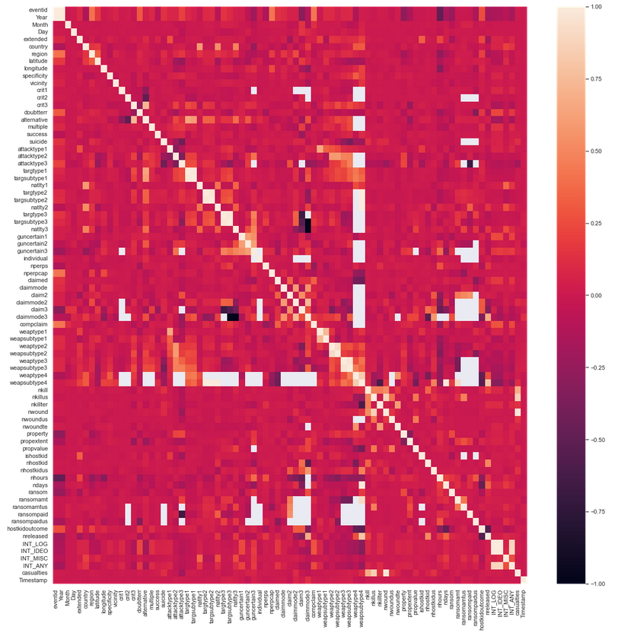
Not very useful
Too cluttered
Most aren’t correlated

Slide 25
Not very useful
Too cluttered
No strong correlation

Slide 26
Data preprocessing
Notes:
To make our lives easier, and for a more reliable model for our machine learning process, we will preprocess the data.

Slide 27
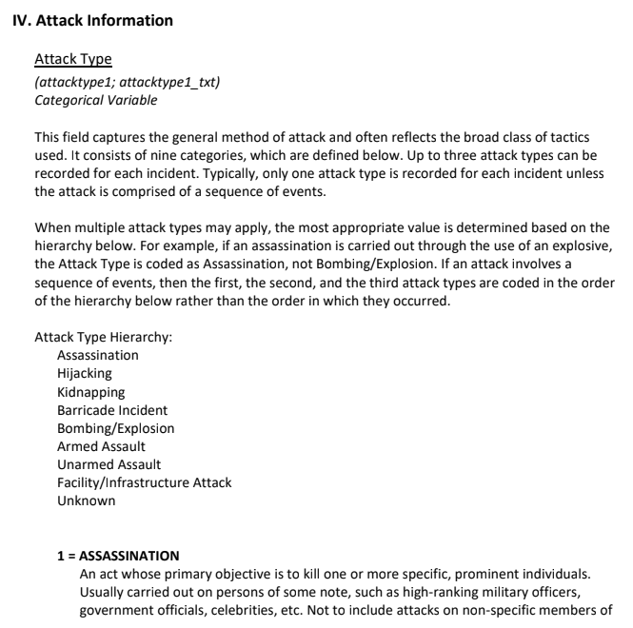

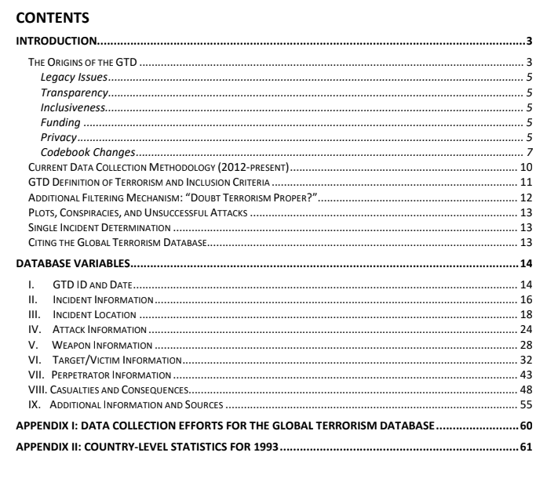
Selection of variables
Notes:
Extremely detailed descriptions of each variable

Slide 28
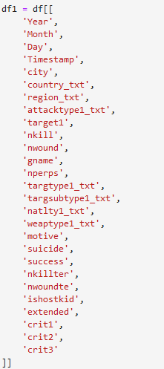
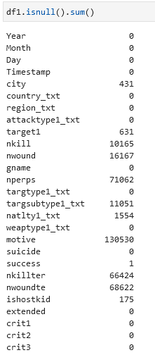
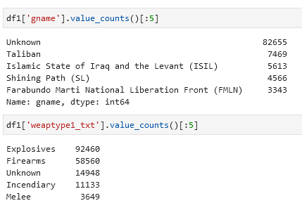
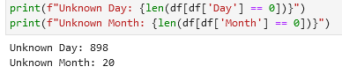
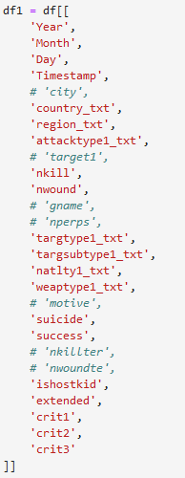
Drop missing data, as well as “unknown” - Removing data points with too many unknown/missing data so as to not drop too much of our sample - Remove text data
27 manually chosen variables
Almost Half
Still less than 10%

Slide 29
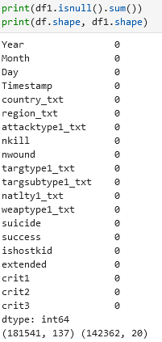
Drop missing data, as well as “unknown” - Removing data points with too many unknown/missing data so as to not drop too much of our sample - Remove text data
27 manually chosen variables
Almost Half
Still less than 10%

Slide 30
Reduced the number of features we need to consider

Slide 31
In the end, 19 features to predict 1 success variable, with 140000 datapoints compared to the initial 180000. Filtered sufficiently, while keeping integrity of our dataset and analysis.

Slide 32
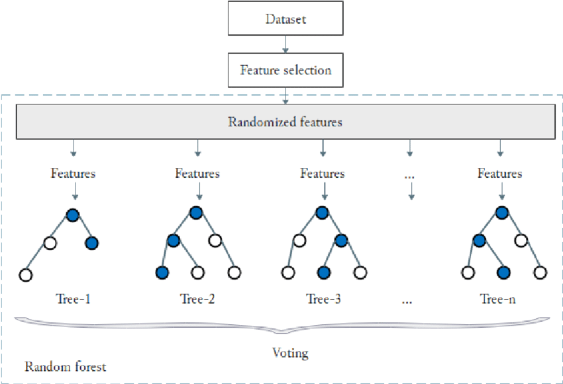
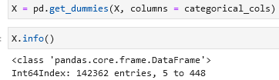
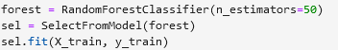
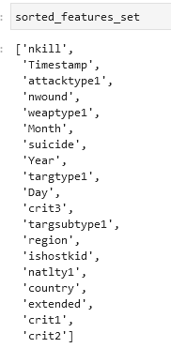
To further gather information on dataset, used random forest to select features
Feature Selection with Random Forest
One-Hot Encoding

Slide 33
To further gather information on dataset, used random forest to select features
One-Hot Encoding
Feature Selection with Random Forest

Slide 34
To further gather information on dataset, used random forest to select features
One-Hot Encoding
Feature Selection with Random Forest
Top 5 generally stay top 5

Slide 35
We found out that this was the order of the importance of features Top 5 features generally stay the same, while the rest appear to be changing, which suggests that the rest are not very important.

Slide 36
After selecting the top features using Random Forest, we cleaned the data again

Slide 37
The dataset
EDA
Machine Learning
Final Insights

Slide 38
The dataset
EDA
Machine Learning
Final Insights

Slide 39
Project Objectives
Identify what determines a successful terrorist attack
Figure out what terrorists really aim to achieve from the attacks

Slide 40
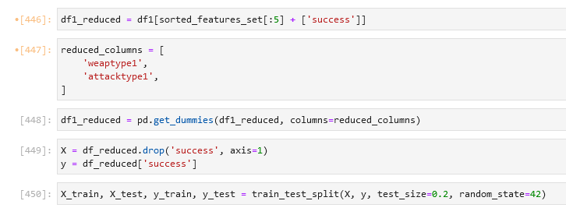
Project Objectives
Used a set of the top 5 most important features as determined by our feature selection
One-hot encoded the categorical data
Used a constant random state so we can ensure that the same output is produced to reduce variability
Identify what determines a successful terrorist attack
Figure out what terrorists really aim to achieve from the attacks
Find the features that are most important in determining the attack
Predicting whether a terrorist attack would occur based on the features - classification problem
Analysis of the motive behind the attack.
Analysis of additional information located in the summary column.
Use the summary column to predict motive

Slide 41
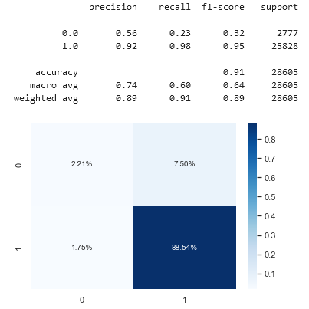
Project Objectives
Identify what determines a successful terrorist attack
Used a set of the top 5 most important features as determined by our feature selection
One-hot encoded the categorical data
Used a constant random state so we can ensure that the same output is produced to reduce variability
Find the features that are most important in determining the attack
Predicting whether a terrorist attack would occur based on the features - classification problem
Random Forest Classifier

Slide 42
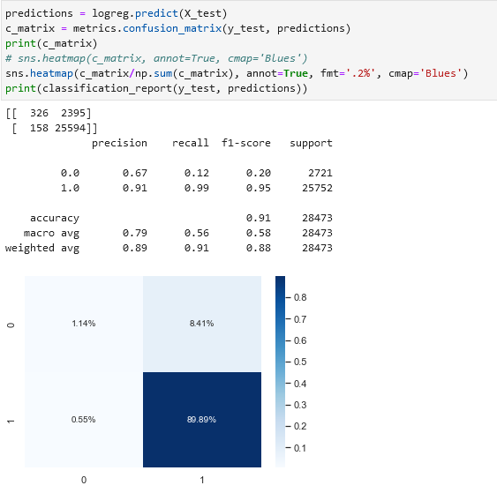
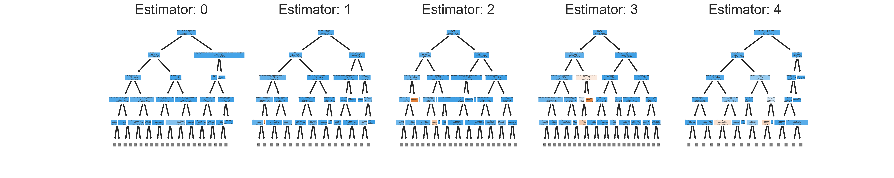
Logistic Regression
Used a set of the top 5 most important features as determined by our feature selection
One-hot encoded the categorical data
Used a constant random state so we can ensure that the same output is produced to reduce variability
Project Objectives
Identify what determines a successful terrorist attack
Random Forest Classifier
Find the features that are most important in determining the attack
Predicting whether a terrorist attack would occur based on the features - classification problem

Slide 43
Identify what determines a successful terrorist attack
Weighted
Random Forest Classifier
Logistic Regression
Although accuracy is high, recall is very low – not a very good model…

Slide 44
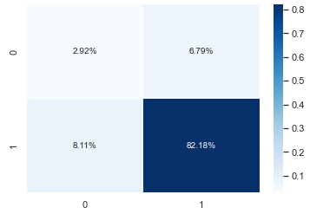


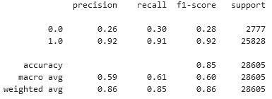
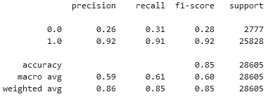
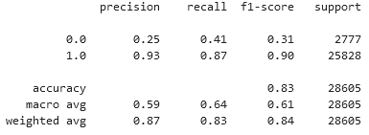
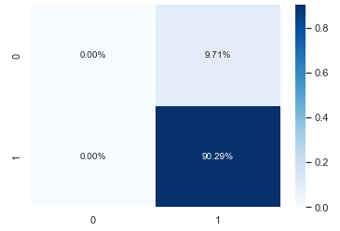


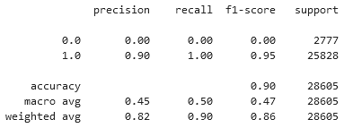
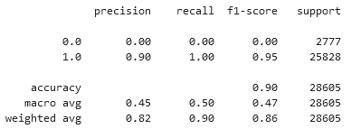
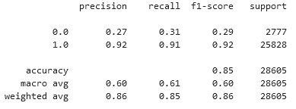
4 Variables
5 Variables
Categorical Variables
1 Variable
2 Variables
3 Variables
Logistic Regression
Weighted

Slide 45
4 Variables
5 Variables
Categorical Variables
Logistic Regression
Weighted
1 Variable
2 Variables
3 Variables

Slide 46
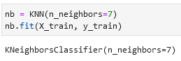
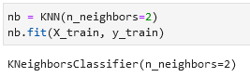

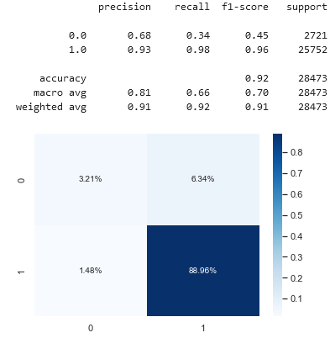
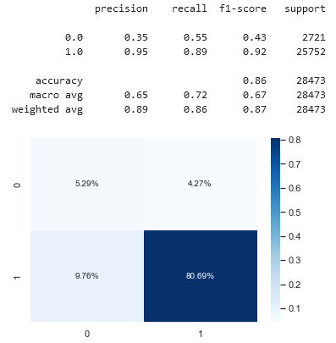
K-Nearest Neigbours

Slide 47
K-Nearest Neigbours

Slide 48
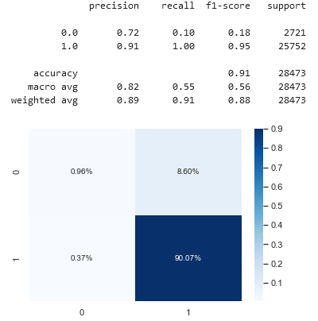


Support Vector Classification
Unweighted
Weighted
Notes:
SVM works by mapping data to a higher dimensional feature space so that data points can be categorized. If it’s linear of course, the results will give us a line that’s best fit among our data that divides the 2 classes.
Because from previous analysis of the dataset, we do understand that our dataset has an unbalanced number of 1s to 0s. Therefore, we tried to find the optimal separating of the hyperplane with automatically correcting the unbalanced classes. It seems that after this test, the precision dropped significantly, while the recall and f1-score increased. The accuracy also decreased, but from this comparison, it does seem that the unweighted model seems to be better than the weighted one. Probably because we customized the weights manually.

Slide 49


Neural Networks
Notes:
Moving on to the next model that we tried, we attempted to use neural networks to train our model because we thought that we might be able to obtain a better predictor. The concept of neural networks is really interesting, NN could also be known as ANN, which is a subset of machine learning and a part of deep learning algorithms. Where they have interconnection between nodes and mimicks the nurons in the human brain. Recognising hidden patterns and correlations in raw data, then condensing it into the important feactures and eventually producing an output based on the previous layers.

Slide 50


Neural Networks
Unweighted
Weighted
Notes:
The results of the neural networks however were quite similar to the non-neural network models.

Slide 51
Attempted methods - Logistic Regression - KNN - etc

Slide 52
Logistic Regression Supervised Learning - Tries to classify success/failures based on continuous/categorical variables

Slide 53
Initially looked promising, but since most are 1s accuracy is high even if predict almost all 1s. Noticed that there were cases where all 1s predicted, accuracy remained at 90% due to 9:1 split as mentioned earlier during EDA.

Slide 54
Tried with different variables and number of variables

Slide 55
K Nearest Neighbours (KNN) -Supervised learning - Finds datapoints closest to it and classifies it based on which class is the majority amongst the neighbours

Slide 56
Tried with different number of nearest neighbours

Slide 57
Neural Nets

Slide 58
Identify what determines a successful terrorist attack
Figure out what terrorists really aim to achieve from the attacks
Find the features that are most important in determining the attack
Predicting whether a terrorist attack would occur based on the features - classification problem
Analysis of the motive behind the attack.
Analysis of additional information located in the summary column.
Use the summary column to predict motive

Slide 59


Figure out what terrorists really aim to achieve from the attacks
Making use of the “unclean” dataset – text data needs its own pre-processing
Analysing text data to extract information
Preprocessing
Changing text to lowercase
Removing punctuation and digits
Remove stop words
Lemmatization

Slide 60

Figure out what terrorists really aim to achieve from the attacks
Making use of the “unclean” dataset – text data needs its own pre-processing
Analysing text data to extract information
Preprocessing
Changing text to lowercase
Removing punctuation and digits
Remove stop words
Lemmatization

Slide 61
Figure out what terrorists really aim to achieve from the attacks
Making use of the “unclean” dataset – text data needs its own pre-processing
Analysing text data to extract information
Preprocessing
Changing text to lowercase
Removing punctuation and digits
Remove stop words
Lemmatization

Slide 62
Motive Column

Slide 63



Bag-of-Words model + Latent Dirichlet Allocation
Most populated topic
Least populated topic

Slide 64


Bag-of-Words model + Latent Dirichlet Allocation
Least populated topic
Most populated topic
TF-IDF

Slide 65
TF-IDF model + Latent Dirichlet Allocation
TF-IDF
Most populated topic
Least populated topic

Slide 66



Bag-of-Words model + Latent Dirichlet Allocation
TF-IDF
Most populated topic
Least populated topic
Evaluation
BOW
TF-IDF

Slide 67
Summary Column

Slide 68


Bag-of-Words model

Slide 69




Machine Learning Models
Kernel SVM
Logistic Regression

Slide 70


Machine Learning Models
Kernel SVM
Logistic Regression
Stochastic Gradient Descent Classifier

Slide 71


Machine Learning Models
Logistic Regression
Stochastic Gradient Descent Classifier
Decision Tree Classifier

Slide 72


Machine Learning Models
Stochastic Gradient Descent Classifier
Decision Tree Classifier
Random Forest Classifier

Slide 73


Machine Learning Models
Decision Tree Classifier
Random Forest Classifier
K-Nearest Neighbours

Slide 74
Machine Learning Models
Random Forest Classifier
K-Nearest Neighbours

Slide 75


Boosting Algorithms
K-Nearest Neighbours
AdaBoost

Slide 76


Boosting Algorithms
Gradient Boosting

Slide 77
Drawbacks

Slide 78
Boosting Algorithms

Slide 79
Model Validation

Slide 80
Outcome and final thoughts

Slide 81
The dataset
EDA
Machine Learning
Final Insights

Slide 82
The dataset
EDA
Machine Learning
Final Insights

Slide 83
Project Objectives
Identify what determines a successful terrorist attack
Figure out what terrorists really aim to achieve from the attacks

Slide 84
Identify what determines a successful terrorist attack
We realized that wanting to determine what makes or breaks a successful terrorist attack was important, so that we could focus on the important combination of features. Coming up with solutions to prevent the attacks from succeeding and hurting many others in the process.
Using these top factors, what were the time periods that was most crucial?
Attack types used that was most common?
Trying to separate crowds because the higher number of people density areas tend to have more successful attacks.
Weapon types that perhaps govenments could ban or clamp down on the circulation of.

Slide 85
Project Objectives
Identify what determines a successful terrorist attack
Analysis of features to determine successful terrorist attack
Design solutions to tackle these main features to prevent successful attacks.
Allows us to mitigate and minimize damage done.
Spread crowds out to minimize casualties
Random Forest Classifier

Slide 86
Project Objectives
Identify what determines a successful terrorist attack
Analysis of features to determine successful terrorist attack
Design solutions to tackle these main features to prevent successful attacks.
Allows us to mitigate and minimize damage done.
More stringent checks on behavior corresponding to certain attack types
Random Forest Classifier

Slide 87
Project Objectives
Identify what determines a successful terrorist attack
Analysis of features to determine successful terrorist attack
Design solutions to tackle these main features to prevent successful attacks.
Allows us to mitigate and minimize damage done.
Ban the use of most popular weapon types
Random Forest Classifier

Slide 88
Project Objectives
Identify what determines a successful terrorist attack
Analysis of features to determine successful terrorist attack
Design solutions to tackle these main features to prevent successful attacks.
Allows us to mitigate and minimize damage done.
And so on…
Random Forest Classifier

Slide 89
Project Objectives
Identify what determines a successful terrorist attack
Figure out what terrorists really aim to achieve from the attacks

Slide 90
Figure out what terrorists really aim to achieve from the attacks
Analysis of motive to determine goal of terrorists
Targeting the motives that are the most harmful and common would serve to reduce the number of successful terror attacks.
Terrorists will not have reason to attack
Creating an environment where all individuals are valued

Slide 91
Figure out what terrorists really aim to achieve from the attacks
Analysis of motive to determine goal of terrorists
Targeting the motives that are the most harmful and common would serve to reduce the number of successful terror attacks.
Terrorists will not have reason to attack
Allow for freedom to practice religion

Slide 92
Figure out what terrorists really aim to achieve from the attacks
Analysis of motive to determine goal of terrorists
Targeting the motives that are the most harmful and common would serve to reduce the number of successful terror attacks.
Terrorists will not have reason to attack
Fair wages

Slide 93
Figure out what terrorists really aim to achieve from the attacks
Analysis of motive to determine goal of terrorists
Targeting the motives that are the most harmful and common would serve to reduce the number of successful terror attacks.
Terrorists will not have reason to attack
Build trust in citizens of the country

Slide 94
Figure out what terrorists really aim to achieve from the attacks
Analysis of motive to determine goal of terrorists
Targeting the motives that are the most harmful and common would serve to reduce the number of successful terror attacks.
Terrorists will not have reason to attack
Ensure everyone is fairly represented

Slide 95






Figure out what terrorists really aim to achieve from the attacks
Analysis of motive to determine goal of terrorists
Targeting the motives that are the most harmful and common would serve to reduce the number of successful terror attacks.
Terrorists will not have reason to attack
Ethical education in schools
Singapore’s Pillars of Total Defence

Slide 96

Figure out what terrorists really aim to achieve from the attacks
Analysis of motive to determine goal of terrorists
Targeting the motives that are the most harmful and common would serve to reduce the number of successful terror attacks.
Terrorists will not have reason to attack
Singapore’s Pillars of Total Defence
Ethical education in schools

Slide 97
Thank you
Pls gib A

Slide 98
Figure out what terrorists really aim to achieve from the attacks
From the consolidation and some research on the general motivations of the perpetrators, we limited our categories to these 6:
Be it for any agenda, the aggression could be curbed even before the execution. Targeting each motive with a niche solution, would reduce the number of terrorists attacks because they simply don’t have a goal to achieve anymore.

Slide 99
Figure out what terrorists really aim to achieve from the attacks
Curb Retaliation
Best practices in an effective anti-retaliation solution include creating an environment where individuals are valued and encouraged to speak up and where criticism for doing so is not tolerated.
Curb Extortion
Making sure that everyone is heard, and feels heard.
Curb Fear
Building strong relationships among the citizens of the country. Having faith in the government that standing together as one is a strong defense against terrorism
Curb Political
Making sure people are represented where it makes a difference. That even the minorities are stood up for and are able to give inputs on the political areas of the country they live in
Curb Violence
Hurting others is never the solution and they are not the judge of someone else life.
Notes:
https://www.ethics.org/document/retaliation-in-the-workplace-defining-responding-to-and-preventing-retaliation/

Slide 100
LR generally good predictions, but other models tend to perform better, like KNN.

Slide 101
Unable to get super high accuracy due to the excessive number of variables, including intangible ones that are not captured in the dataset - Intelligence held by armies in each case - Amount of planning gone into each attack - Backstabbing/double-crossing - Internal conflicts

Slide 102
How to keep safe?

Slide 103
Other things we have tested which are not super useful or we didn’t figure out how to get work - Weighted Logistic Regression - Grid search (GridSearchCV) takes too long - NLP to analyse text data

Slide 104
Things we have learnt and used outside of course

Slide 105
Visualization: - Plotly (Interactive plots) Maps: - Folium, Kepler Machine Learning - Random Forest (Feature Selection) - K-Nearest Neighbours - Weighted Logistic Regression - Boosting Algorithms - Model Validation tools

Slide 106
Statistics & Results
Jupiter
100
90
40%
Jupiter is a gas giant and the biggest planet in the Solar System
80
70
60
50
40
Mars
30
35%
Despite being red, Mars is a cold place full of iron oxide dust
20
10
SU
M
TU
W
TH
F
SA

Slide 107
Statistics & Results
Jupiter
Mercury
Venus
Mars
Jupiter is a gas giant and the biggest planet in the Solar System
Mercury is the closest planet from the Sun and the smallest one
Venus has a beautiful name and is the second planet from the Sun
Despite being red, Mars is actually a cold place full of iron oxide dust
50%
30%
80%
100%

Slide 108
Statistics & Results
Jupiter
60%
Jupiter is a gas giant and the biggest planet in the Solar System
Venus
80%
Venus has a beautiful name and is the second planet from the Sun
Mars
30%
Despite being red, Mars is actually a cold place full of iron oxide dust
Mercury
70%
Mercury is the closest planet from the Sun and the smallest one

Slide 109
Statistics & Results
20%
40%
30%
60%
30%
Mercury
Venus
Jupiter
Saturn
Mars
Mercury is the closest planet to the Sun
Venus is the second planet from the Sun
Jupiter is the biggest planet of them all
It is a ringed planet and a gas giant
Despite being red, Mars is a cold place

Slide 110
Statistics & Results
30%
Venus has a beautiful name and is the second planet from the Sun
45%
Venus
Mercury is the closest planet from the Sun and the smallest one
25%
Despite being red, Mars is actually a cold place full of iron oxide dust

Slide 111
Statistics & Results
50%
Jupiter
Jupiter is a gas giant and the biggest planet in the Solar System
60%
Venus
Venus has a beautiful name and is the second planet from the Sun
Mars
Despite being red, Mars is actually a cold place full of iron oxide dust
70%
80%
Mercury
Mercury is the closest planet from the Sun and the smallest one

Slide 112
Statistics & Results
90%
30%
60%
75%
Mercury
Venus
Jupiter
Saturn
Mercury is the closest planet to the Sun
Venus is the second planet from the Sun
Jupiter is the biggest planet of them all
It is a ringed planet and a gas giant

Slide 113
Statistics & Results
Jupiter is a gas giant and the biggest planet in the Solar System
Jupiter
Venus has a beautiful name and is the second planet from the Sun
Venus
Despite being red, Mars is actually a cold place full of iron oxide dust
Mars
Mercury is the closest planet from the Sun and the smallest one
40%
20%
50%
10%
Mercury

Slide 114
Statistics & Results
15%
20%
Mercury is the closest planet from the Sun and also the smallest one
Venus has a beautiful name and is the second planet from the Sun
30%
35%
Jupiter is a gas giant and the biggest planet in the entire Solar System
Despite being red, Mars is actually a cold place full of iron oxide dust

Slide 115
Statistics & Results
50%
20%
30%
20%
Mars
Neptune
Jupiter
Saturn
Despite being red, Mars is a cold place
Neptune is the farthest planet from the Sun
Jupiter is a gas giant and the biggest planet
It’s composed of hydrogen and helium

Slide 116
Statistics & Results
60%
80%
Mercury
Jupiter
Mercury is the closest planet from the Sun
Jupiter is a gas giant and the biggest planet
50%
70%
Venus
Mars
Venus is the second planet from the Sun
Despite being red, Mars is actually cold

Slide 117
Statistics & Results
Venus
Mercury
Venus has a beautiful name and is the second planet from the Sun
Mercury is the closest planet from the Sun and the smallest one
Mars
Jupiter
Despite being red, Mars is actually a cold place full of iron oxide dust
Jupiter is a gas giant and the biggest planet in the Solar System
20%
60%
80%
45%

Slide 118
Statistics & Results
Mercury
Venus
Mercury is the closest planet from the Sun and the smallest one
Venus has a beautiful name and is the second planet from the Sun
50%
15%
Jupiter
Mars
35%
Jupiter is a gas giant and the biggest planet in the Solar System
60%
Despite being red, Mars is actually a cold place full of iron oxide dust

Slide 119
Statistics & Results
Venus
75%
Venus has a beautiful name and is the second planet from the Sun
Mercury
60%
Mercury is the closest planet to the Sun and the smallest of them all
Mars
50%
Despite being red, Mars is actually a cold place full of iron oxide dust

Slide 120
Statistics & Results
50%
45%
30%
20%
Mercury
Jupiter
Venus
Mars
Mercury is the closest planet from the Sun
Jupiter is a gas giant and the biggest planet
Venus is the second planet from the Sun
Despite being red, Mars is actually cold

Slide 121
Statistics & Results
80%
70%
50%
90%
Venus
Mars
Mercury
Saturn
Venus has a beautiful name
Mars is actually a cold place
Mercury is the smallest planet
Saturn is a gas giant and has rings

Slide 122
Statistics & Results
Jupiter
35%
Venus has a beautiful name and is the second planet from the Sun
Mercury
45%
Mercury is the closest planet to the Sun and the smallest of them all
Neptune
20%
Despite being red, Mars is actually a cold place full of iron oxide dust

Slide 123
Statistics & Results
50%
40%
20%
30%
Mercury
Venus
Jupiter
Saturn
Mercury is the closest planet to the Sun
Venus is the second planet from the Sun
Jupiter is the biggest planet of them all
It is a ringed planet and a gas giant

Slide 124
Statistics & Results
75%
Jupiter
Jupiter is a gas giant and the biggest planet in the Solar System
15%
Venus
Venus has a beautiful name and is the second planet from the Sun
10%
Mars
Despite being red, Mars is actually a cold place full of iron oxide dust

Slide 125
Statistics & Results
50%
25%
75%
50%
Mercury
Venus
Jupiter
Saturn
Mercury is the closest planet to the Sun
Venus is the second planet from the Sun
Jupiter is the biggest planet of them all
It is a ringed planet and a gas giant

Slide 126
Statistics & Results
65%
85%
Venus is the second planet from the Sun
Jupiter is the biggest planet of them all
80%
95%
Mercury is the closest planet to the Sun
It is a ringed planet and a gas giant

Slide 127
Statistics & Results
20%
Mars
Despite being red, Mars is a cold place
30%
Jupiter
50%
Jupiter is a gas giant and the biggest planet
Neptune
Neptune is the farthest planet from the Sun

Slide 128
Statistics & Results
Mercury
Venus
Mercury is the closest planet from the Sun and the smallest one
Venus has a beautiful name and is the second planet from the Sun
Jupiter
Mars
Jupiter is a gas giant and the biggest planet in the Solar System
50%
35%
60%
85%
Despite being red, Mars is actually a cold place full of iron oxide dust

Slide 129
Statistics & Results
50%
75%
25%
60%
Mercury
Venus
Jupiter
Saturn
Mercury is the closest planet to the Sun
Venus is the second planet from the Sun
Jupiter is the biggest planet of them all
It is a ringed planet and a gas giant

Slide 130
Statistics & Results
Jupiter is a gas giant and the biggest planet in the Solar System
Jupiter
6/10
Venus has a beautiful name and is the second planet from the Sun
Venus
7/10
Despite being red, Mars is actually a cold place full of iron oxide dust
Mars
8/10
Mercury is the closest planet from the Sun and the smallest one
Mercury
9/10

Slide 131
Statistics & Results
75%
100%
50%
Venus
Jupiter
Saturn
Venus is the second planet from the Sun
Jupiter is the biggest planet of them all
It is a ringed planet and a gas giant

Slide 132
Statistics & Results
Venus
Mars
80%
Venus has a beautiful name and is the second planet from the Sun
70%
Despite being red, Mars is a cold place full of iron oxide dust
Mercury
Jupiter
25%
Mercury is the closest planet to the Sun and the smallest one
90%
Jupiter is a gas giant and the biggest planet in the Solar System

Slide 133
Statistics & Results
60%
80%
January
Mercury
Jupiter
February
Mercury is the closest planet from the Sun
Jupiter is a gas giant and the biggest planet
March
April
50%
70%
May
Venus
Mars
June
Venus is the second planet from the Sun
Despite being red, Mars is actually cold
0
10
15
20
25
30

Slide 134
Statistics & Results
90%
Jupiter
80%
Jupiter is a gas giant and the biggest planet in the Solar System
Venus
60%
Venus has a beautiful name and is the second planet from the Sun
45%
Mars
Despite being red, Mars is actually a cold place full of iron oxide dust
Mercury
Mercury is the closest planet from the Sun and the smallest one

Slide 135
Statistics & Results
Venus
50%
45%
Mercury
Venus has a beautiful name and is the second planet from the Sun
Mercury is the closest planet from the Sun and the smallest one
Mars
30%
45%
Jupiter
Despite being red, Mars is actually a cold place full of iron oxide dust
Jupiter is a gas giant and the biggest planet in the Solar System

Slide 136
Instructions for use (free users)
In order to use this template, you must credit Slidesgo by keeping the Thanks slide.
You are allowed to:
Modify this template.
Use it for both personal and commercial purposes.
You are not allowed to:
Sublicense, sell or rent any of Slidesgo Content (or a modified version of Slidesgo Content).
Distribute this Slidesgo Template (or a modified version of this Slidesgo Template) or include it in a database or in any other product or service that offers downloadable images, icons or presentations that may be subject to distribution or resale.
Use any of the elements that are part of this Slidesgo Template in an isolated and separated way from this Template.
Delete the “Thanks” or “Credits” slide.
Register any of the elements that are part of this template as a trademark or logo, or register it as a work in an intellectual property registry or similar.
For more information about editing slides, please read our FAQs or visit Slidesgo School:
https://slidesgo.com/faqs and https://slidesgo.com/slidesgo-school

Slide 137
Instructions for use (premium users)
In order to use this template, you must be a Premium user on Slidesgo.
You are allowed to:
Modify this template.
Use it for both personal and commercial purposes.
Hide or delete the “Thanks” slide and the mention to Slidesgo in the credits.
Share this template in an editable format with people who are not part of your team.
You are not allowed to:
Sublicense, sell or rent this Slidesgo Template (or a modified version of this Slidesgo Template).
Distribute this Slidesgo Template (or a modified version of this Slidesgo Template) or include it in a database or in any other product or service that offers downloadable images, icons or presentations that may be subject to distribution or resale.
Use any of the elements that are part of this Slidesgo Template in an isolated and separated way from this Template.
Register any of the elements that are part of this template as a trademark or logo, or register it as a work in an intellectual property registry or similar.
For more information about editing slides, please read our FAQs or visit Slidesgo School:
https://slidesgo.com/faqs and https://slidesgo.com/slidesgo-school

Slide 138
Infographics
You can add and edit some infographics to your presentation to show your data in a visual way.
Choose your favourite infographic and insert it in your presentation using Ctrl C + Ctrl V or Cmd C + Cmd V in Mac.
Select one of the parts and ungroup it by right-clicking and choosing “Ungroup”.
Change the color by clicking on the paint bucket.
Then resize the element by clicking and dragging one of the square-shaped points of its bounding box (the cursor should look like a double-headed arrow). Remember to hold Shift while dragging to keep the proportions.
Group the elements again by selecting them, right-clicking and choosing “Group”.
Repeat the steps above with the other parts and when you’re done editing, copy the end result and paste it into your presentation.
Remember to choose the “Keep source formatting” option so that it keeps the design. For more info, please visit Slidesgo School.

